Slide 1
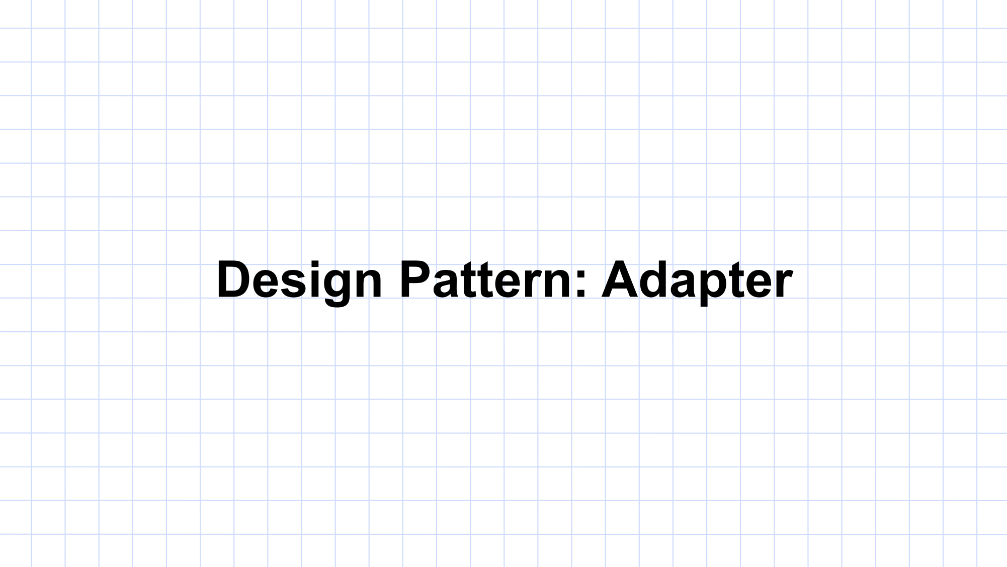

Slide 2
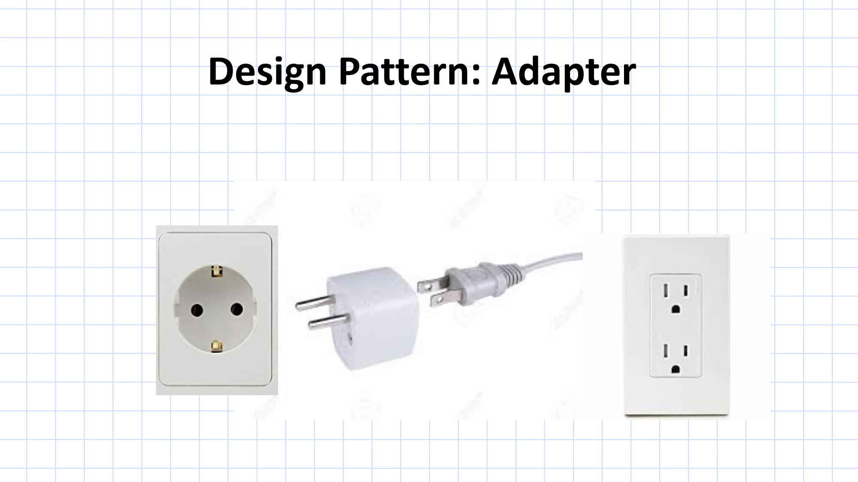

Slide 3
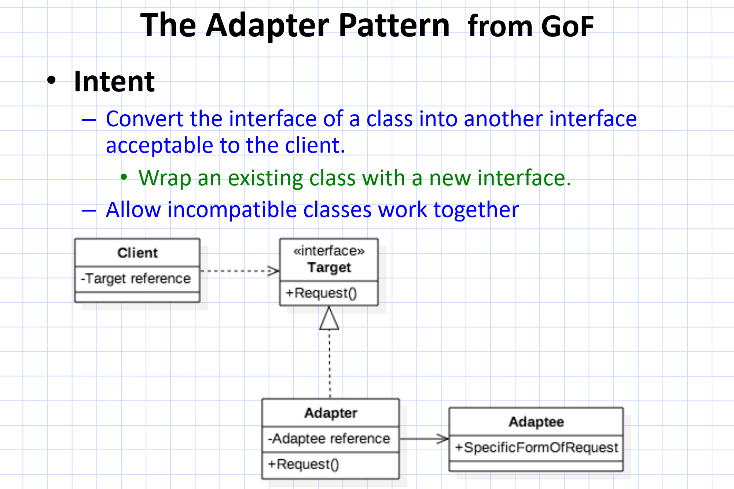

Slide 4
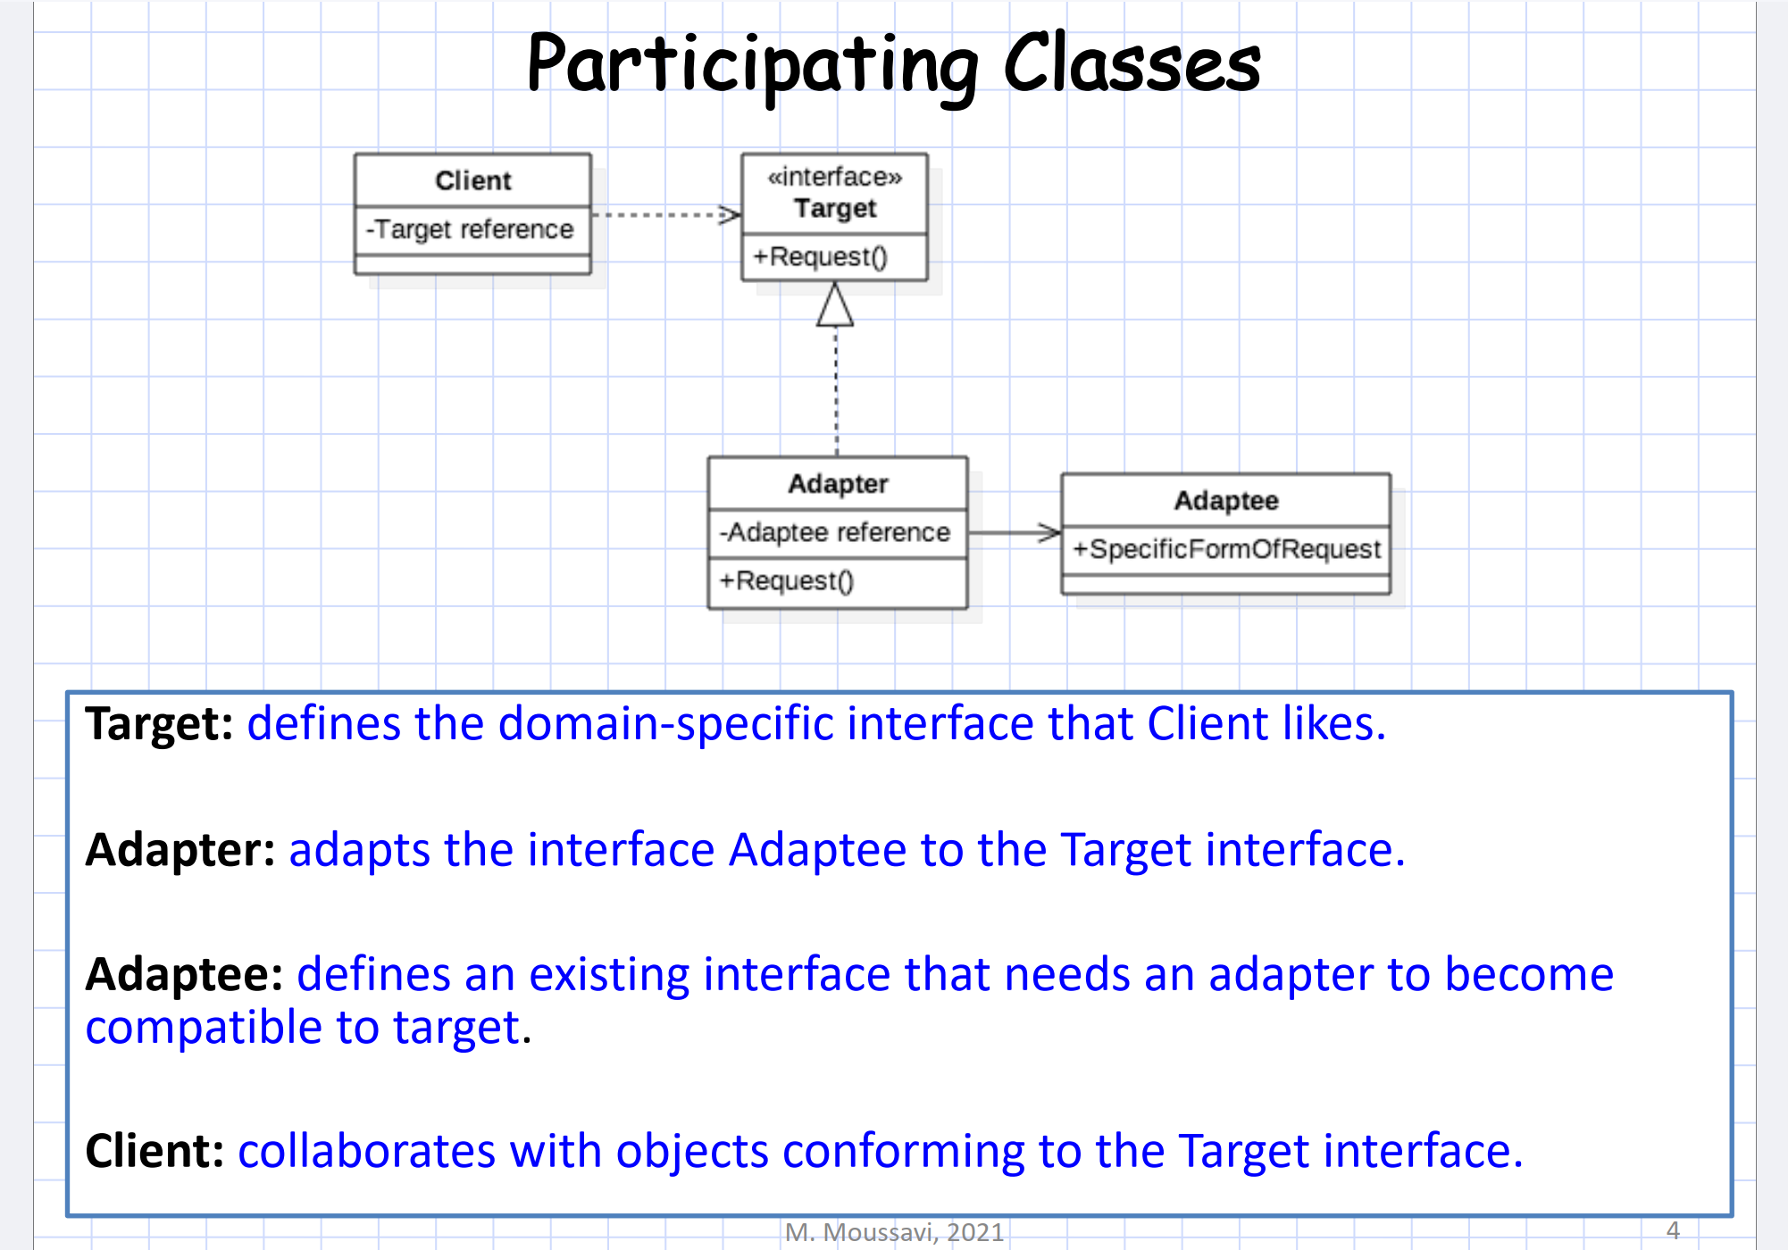

Slide 5
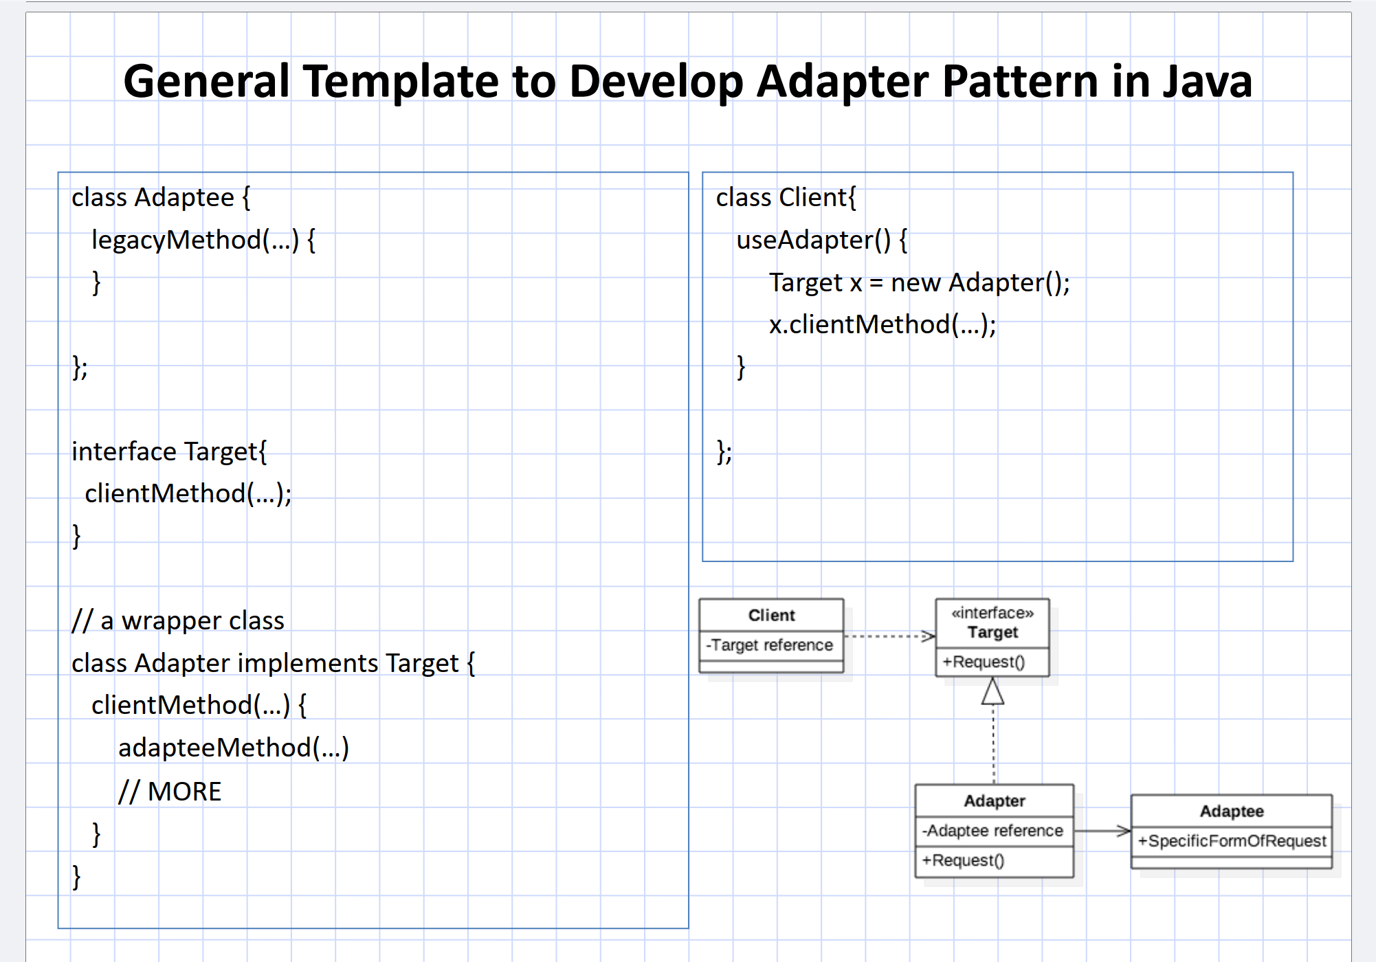

Slide 7
Problem
A Teacher uses a specific interface to interact with a Student, but the Student class has a different method for interacting.
The Client (Teacher) expects the Student to provide a method called submitAssignment().
However, the Student class has a method called giveAssignment(), which does essentially the same thing but uses a different name.
We want to allow the Teacher to interact with the Student without changing the Student class or the way the Teacher works. We will use the Adapter Pattern to make this work.

Slide 8
Target Interface (Expected by the Teacher)
// This is the interface the Teacher expects the Student to implement.
interface StudentInterface {
void submitAssignment(); // The method the Teacher expects
}

Slide 9
Adaptee Class (Existing Student with an incompatible interface)
// This is the Adaptee: the Student class with a different method.
class Student {
public void giveAssignment() {
System.out.println("Student is submitting the assignment using giveAssignment()");
}
}

Slide 10
Adapter Class (Bridges the Teacher and Student
class StudentAdapter implements StudentInterface {
private Student student;
// Constructor to wrap the Student instance
public StudentAdapter(Student student) {
this.student = student;
}
// This method adapts the giveAssignment() method to submitAssignment().
@Override
public void submitAssignment() {
// Internally, it calls the giveAssignment() method from Student
student.giveAssignment();
}
}

Slide 11
Client Class (Teacher interacting with the Student via the Adapter)
class Teacher {
// The Teacher uses the StudentInterface to interact with a student.
public void collectAssignment(StudentInterface student) {
student.submitAssignment();
}
}

Slide 12
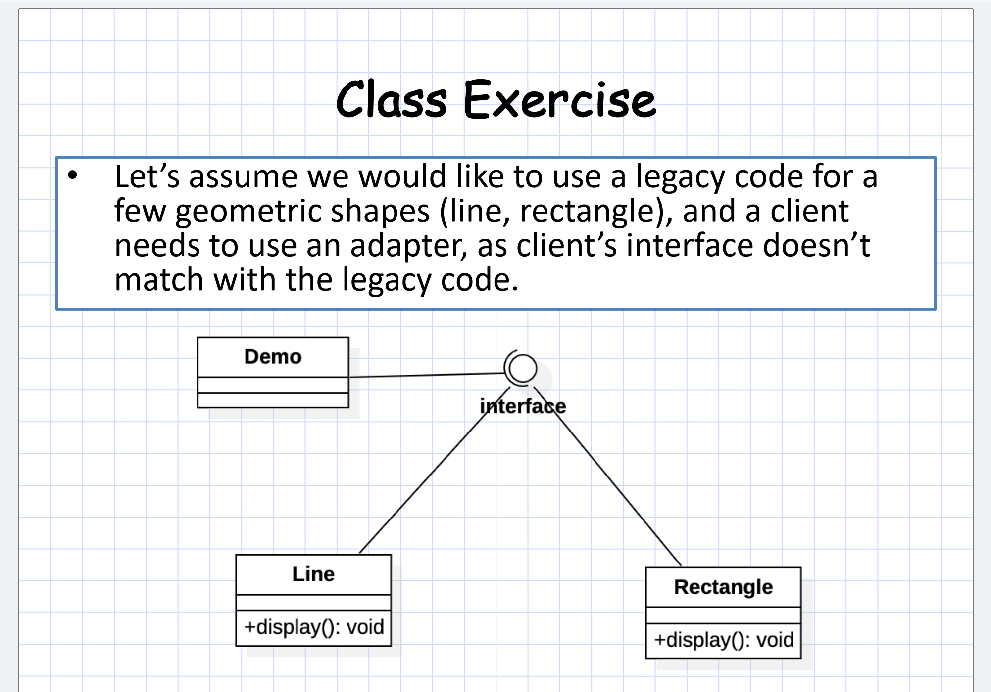

Slide 13
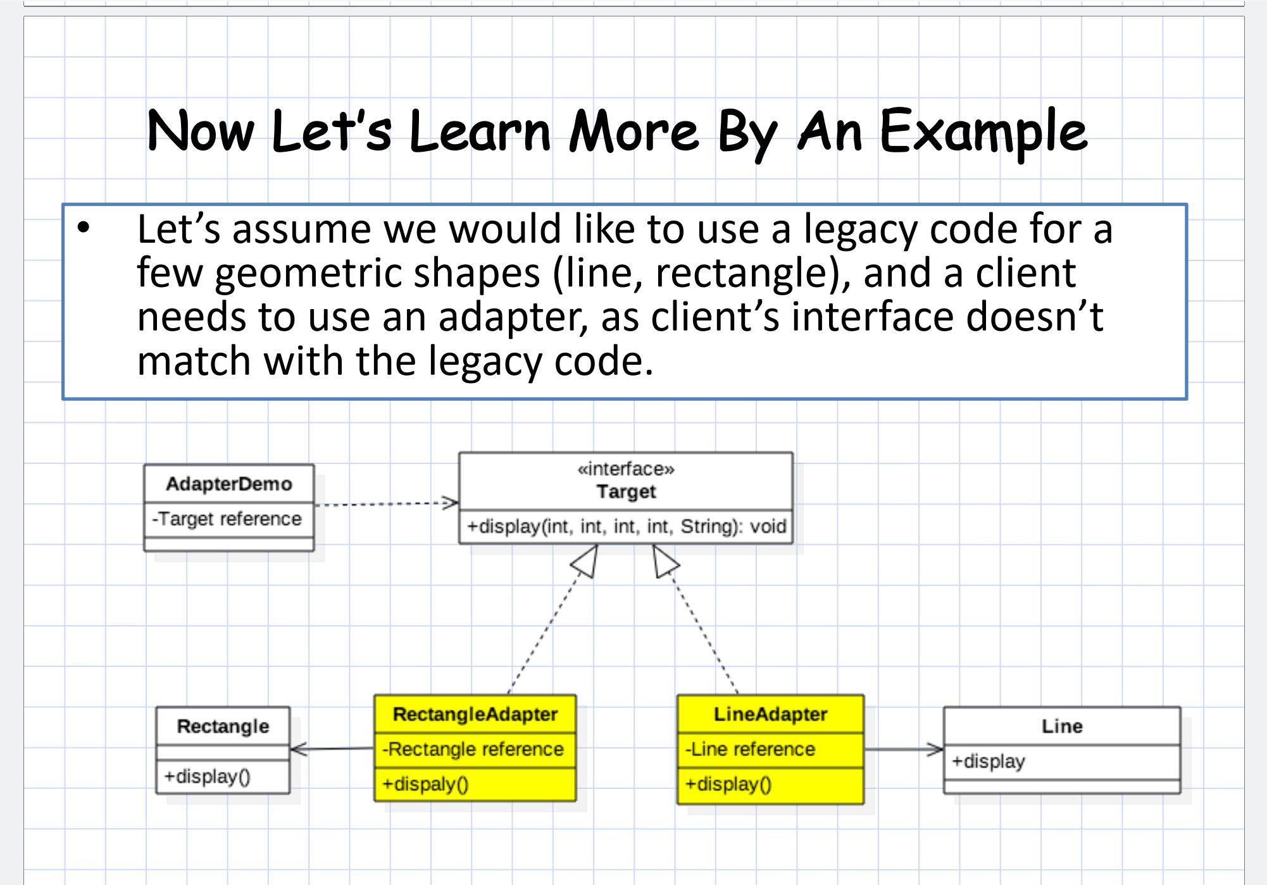

Slide 14
Java Implementation
class Line {
public void display() {
System.out.println("Drawing a line.");
}
}
class Rectangle {
public void display() {
System.out.println("Drawing a rectangle.");
}
}
interface Shape {
void display(int x1, int y1, int x2, int y2, String color);
}

Slide 15
Java Implementation
// Adapter for the Line class
class LineAdapter implements Shape {
private Line line;
public LineAdapter(Line line) {
this.line = line;
}
@Override
public void display(int x1, int y1, int x2, int y2, String color) {
System.out.println("Adapting Line with coordinates (" + x1 + "," + y1 + ") to (" + x2 + "," + y2 + ") and color: " + color);
line.display(); // Calls the legacy Line's display method
}
}
// Adapter for the Rectangle class
class RectangleAdapter implements Shape {
private Rectangle rectangle;
public RectangleAdapter(Rectangle rectangle) {
this.rectangle = rectangle;
}
@Override
public void display(int x1, int y1, int x2, int y2, String color) {
System.out.println("Adapting Rectangle with coordinates (" + x1 + "," + y1 + ") to (" + x2 + "," + y2 + ") and color: " + color);
rectangle.display(); // Calls the legacy Rectangle's display method
}
}

Slide 16
Java Implementation
// Client that uses the Target interface to interact with shapes
public class AdapterDemo {
public static void main(String[] args) {
// Legacy objects
Line line = new Line();
Rectangle rectangle = new Rectangle();
// Adapting legacy objects
Shape lineAdapter = new LineAdapter(line);
Shape rectangleAdapter = new RectangleAdapter(rectangle);
// Client interacting with shapes via the adapter
lineAdapter.display(0, 0, 10, 10, "red");
rectangleAdapter.display(20, 20, 50, 50, "blue");
}
}

